Slide 1
IA 416 - CLOUD COMPUTING SECURITY
LECTURE 1
Dept of Comp Sc and Engineering
CIVE-UDOM
2026-11-03

Slide 2
Cloud
AI
Big Data
Analytics
Contents
Introduction
Business drivers that exposed the need for cloud computing
Pre-existing technologies considered to be the primary influences on cloud computing.
Cloud computing enabling technologies
Key characteristics of cloud computing
Benefits of Cloud Computing
Risks and Challenges of Cloud Computing

Slide 3
Introduction
Cloud computing is the delivery of hosting services that are provided to a client over the Internet.
  Enable large-scale services without up-front investment.
  Cloud computing is a style of computing in which scalable and elastic IT-enabled capabilities are delivered as a service to external customers using Internet technologies.
  It eliminate the need for organization to invest in and maintain their own physical infrastructure, offering flexibility and scalability

Slide 4
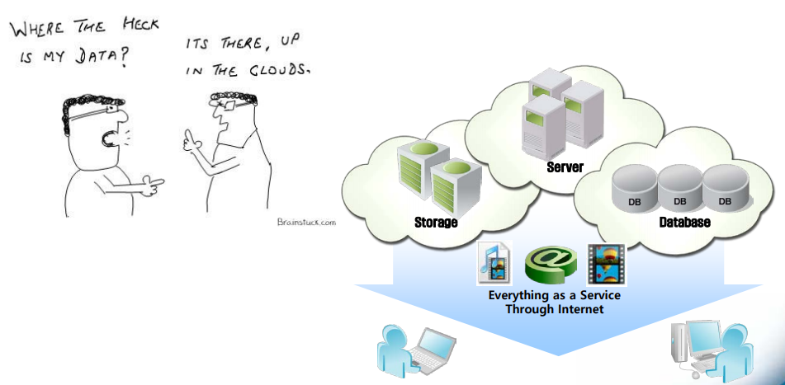
Introduction

Slide 5
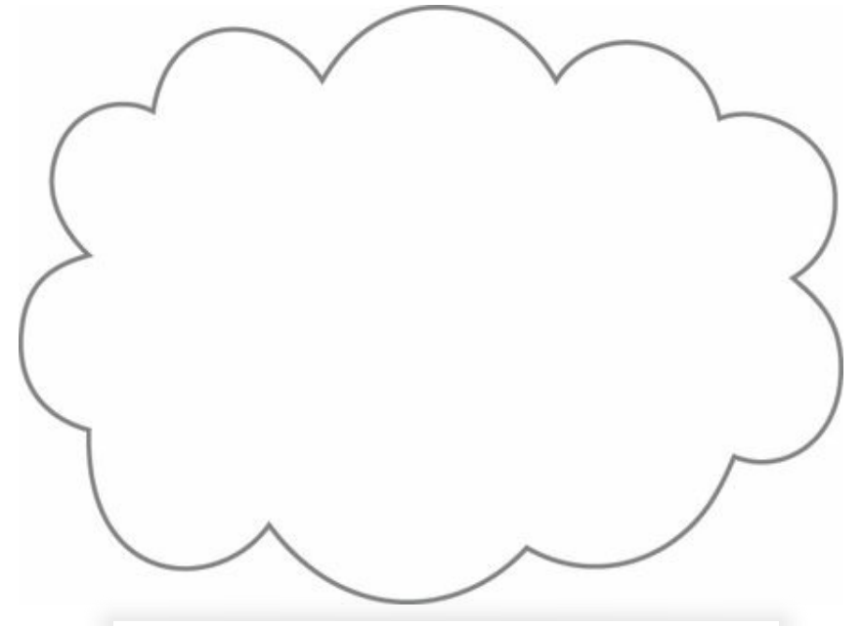
Introduction
A cloud refers to a distinct IT environment that is designed for the purpose of remotely provisioning scalable and measured IT resources.
The symbol used to present the boundary of a cloud environment are shown below:

Slide 6
Business drivers that exposed the need for cloud computing
Capacity Planning: is the process of determining and fulfilling future demands of an organization’s IT resources, products, and services. Within this context, capacity represents the maximum amount of work that an IT resource is capable of delivering in a given period of time.
Different capacity planning strategies exist:
  Lead Strategy: adding capacity to an IT resource in anticipation of demand
  Lag Strategy – adding capacity when the IT resource reaches its full capacity.
  Match Strategy – adding IT resource capacity in small increments, as demand increases.

Slide 7
Business drivers that exposed the need for cloud computing
Cost reduction: A direct alignment between IT costs and business performance can be difficult to maintain.
The cost maybe related to the cost of acquiring new infrastructure and the cost of its ongoing ownership.
Common forms of infrastructure-related operating overhead include the following:
  Technical personnel required to keep the environment operational.
  Upgrades and patches that introduce additional testing and deployment cycles.
  Utility bills and capital expense investments for power and cooling.
  Security and access control measures that need to be maintained and enforced to protect infrastructure resources.
  Administrative and accounts staff that may be required to keep track of licenses and support arrangements.

Slide 8
Business drivers that exposed the need for cloud computing
Organization agility: is the measure of an organization’s responsiveness to change.
An IT enterprise often needs to respond to business change by scaling its IT resources beyond the scope of what was previously predicted or planned for.
For example, infrastructure may be subject to limitations that prevent the organization from responding to usage fluctuations—even when anticipated—if previous capacity planning efforts were restricted by inadequate budgets.
In other cases, changing business needs and priorities may require IT resources to be more available and reliable than before.

Slide 9
Pre-existing technologies considered to be the primary influences on cloud computing
Grid computing:
  It involves a distributed network of computers that work together to process large tasks.
  It connects various computers across different locations, often using the internet, allowing them to share resources and perform computations that would be too resource-intensive for a single machine.
  Grid computing differs from Clustering in that grid systems are much more loosely coupled and distributed. As a result, grid computing systems can involve computing resources that are heterogeneous and geographically dispersed, which is generally not possible with cluster computing-based systems.
  Grid computing is typically used for high-performance tasks like scientific simulations, data analysis, and complex calculations.
Notes:
Generally, grid computing is about distributed resource sharing across potentially vast distances, while clustering focuses on tightly coupled systems that work together to enhance performance and reliability.

Slide 10
Pre-existing technologies considered to be the primary influences on cloud computing
Clustering:
  A cluster is a group of independent IT resources that are interconnected and work as a single system.
  Clustering reduces system failure rates while increasing availability and reliability, since redundancy and failover features are inherent to the cluster.
  Clustering have reasonably identical hardware and operating systems to provide similar performance levels when one failed component is to be replaced by another.
  Component devices that form a cluster are kept in synchronization through dedicated, high-speed communication links.

Slide 11
Pre-existing technologies considered to be the primary influences on cloud computing
Clustering:
  Practical Example that Distinguishes between Clustering and Grid Computing
  Consider a university conducting AI research that requires substantial computing power.
  Cluster Computing: The university connects 20 high-performance computers in its data center to train a deep learning model. These computers operate as a coordinated computing system.
  Grid Computing: The university collaborates with three other universities in different countries, sharing their computing resources to process large research datasets

Slide 12
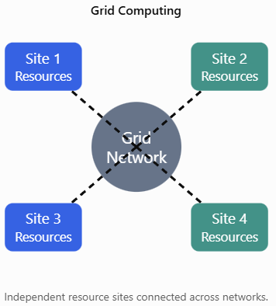
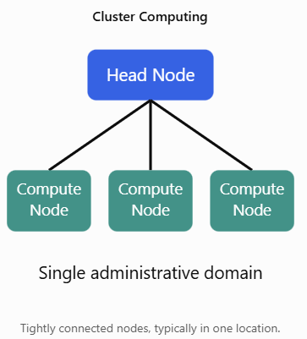
Pre-existing technologies considered to be the primary influences on cloud computing
Clustering:
  Practical Example that Distinguishes between Clustering and Grid Computing

Slide 13
Pre-existing technologies considered to be the primary influences on cloud computing
Virtualization:
  Virtualization represents a technology platform used for the creation of virtual instances of IT resources.
  A layer of virtualization software allows physical IT resources to provide multiple virtual images of themselves so that their underlying processing capabilities can be shared by multiple users.
  Prior to the advent of virtualization technologies, software was limited to residing on and being coupled with static hardware environments.
  As cloud computing evolved, a generation of modern virtualization technologies emerged to overcome the performance, reliability, and scalability limitations of traditional virtualization platforms.

Slide 14
Cloud computing enabling technologies
The following areas of technology continue to contribute to modern-day cloud- based platforms.
  Broadband Networks and Internet Architecture
  Data Center Technology
  Virtualization Technology
  Web Technology
  Multitenant Technology
  Service Technology
  Each of these cloud-enabling technologies existed in some form prior to the formal advent of cloud computing.
  Some were refined further, and on occasion even redefined, as a result of the subsequent evolution of cloud computing.

Slide 15
Key Characteristic of cloud computing
On-demand self-services: Users can provision and manage resources as needed without human intervention.
Broad network access: Cloud services are accessible over the internet from various devices.
Resource pooling: Computing resources are shared among multiple users to maximize efficiency.
Rapid elasticity: Resources can be scaled up or down quickly to meet demand.
Measured services: Cloud usage is metered, and users pay only for what they consume (pay-per-use).

Slide 16
Benefit of Cloud Computing
Cost savings: Cloud computing reduces capital expenses, as organization pay for resources as they use them.
Scalability: Easily scale resources up or down to accommodate changing needs.
Flexibility: Access resources from anywhere with an internet connection.
Reliability: Cloud providers offer high availability and redundancy.
Innovation: Cloud enables the adoption of new technologies quickly.

Slide 17
Risk and Challenge of Cloud Computing
Security concerns: Data breaches and unauthorized access can be concerns.
Data privacy: Storing data off-site may raise privacy and compliance issue.
Downtime: Reliance on cloud providers can lead to downtime incase of outages.
Data transfer cost: Transmitting large amount of data to and from cloud may incur charges.
Vendor lock-in: Organization may become dependent on a single cloud provider.

Slide 18
Thank You

