Slide 1
IA 315: Information Security Auditing and Assurance
Lecture 5: Risk Management and Business Continuity Planning
Presented by:
Dr. Jabhera Matogoro
E-mail: jabhera.Matogoro@udom.ac.tz

Slide 2
Introduction to Risk Management
Risk:
  It is the probability that something bad might happen
Risk Management:
  It is concerned with the potential loss, including economic loss, human suffering or that which may prevent the organization from being able to achieve its goals
  It is a conscious effort of planning, organizing, directing and controlling resources and activities.
  It is used to minimize the adverse effects of accidental loss at the least acceptable cost.

Slide 3
Critical Elements of Risk
Potential injury or loss
The uncertainty of that injury or loss occurring
The significance of the injury or loss

Slide 4
Acceptable Risk
A risk that requires no treatment to ensure that there will be no impact on corporate objectives measured in terms of consequence and likelihood.

Slide 5
Unacceptable Risk
A risk that which, if not treated, will have serious clinical, financial or organizational impact on corporate objectives measured in terms of likelihood and consequence.

Slide 6
Risk Management Decision Process
Identify:
  Possible losses and damages to human and physical resources
  Where the exposure comes from
  How frequently they occur and their severity.
Evaluate:
  Risk Management techniques – we take calculated risks.

Slide 7
Risk Management Decision Process...
Select:
  Appropriate techniques
Implement:
  Chose and use techniques

Slide 8
Types of Risk and Loss
General Liability
Workers’ Compensation
Property Loss – building & contents
Information Management
Auxiliary Enterprises
Business Interruption
Institutional reputation and image loss
Contractual Activities
Financial
Legal Liability
Hardware & Software
Vehicle

Slide 9
Evaluate Loss Potential
Evaluation techniques:
  Frequency/severity of claims
  Publications/periodicals/other universities
  Political/litigation climate
  Anticipate

Slide 10
Challenges to Risk Management - Internal
Challenges to Risk Management - Internal
  Too much focus on the past
  Reluctance to change
  Negative assumptions e.g. cost and outcomes
  Lack of communication

Slide 11
Challenges to Risk Management - External
Insurance market
Vendors
Unions
Auxiliary organizations

Slide 12
Risk Management and Information Technology Infrastructure Library (ITIL)
Disaster:
  Not part of daily operational activities and requires a separate system.
Risk:
  A possible event that could cause harm or loss, or affect the ability to achieve objectives.
  A risk is measured by the probability of a threat, the vulnerability of the asset to that threat, and the impact it would have if it occurred

Slide 13
IT Service Continuity Management
Objective
  To support the overall Business Continuity Management by ensuring that the required IT technical and service facilities (including computer systems, networks, applications, data repositories, telecommunications, environment, technical support and Service Desk) can be resumed within required, and agreed, business time scales.

Slide 14
Business Continuity Management and Risk Assessment
Business Continuity Management (BCM):
  It the business process responsible for managing risk that could seriously affect the BCM safeguards and interests of key stakeholders, reputation, brand and value-creating activities.
  The BCM Process involves reducing risks to an acceptable level and planning for the recovery of business processes should a disruption to the Business occur.
  BCM sets the objectives, scope and requirements for IT Service Continuity Management.
Risk Assessment:
  The initial steps of risk management.
  Analyzing the value of assets to the business, identifying threats to those assets, and evaluation how vulnerable each asset is to those threats.
  Risk Assessment can be quantitative (based on numerical) or qualitative

Slide 15
Business Continuity Management and Risk Assessment…
Counter Measures: Measures to prevent or recover from disaster
Manual Workaround: Using non-IT based solution to overcome IT service disruption
Gradual recovery: aka cold standby (>72hrs)
Intermediate Recovery: aka warm standby (24-72hrs)
Immediate Recovery: aka hot standby (< 24hrs, usually implies 1-2 hrs)
Reciprocal Arrangement: Agreement with another similar sized company to share disaster recovery obligations

Slide 16
Business Continuity Management and Risk Assessment: Scope
All identified critical business processes and IT service(s) that underpin them.
May include hardware, software, accommodation, critical paper records, courier services, voice services & customer reception areas.
Consider the organization’s BCM, dependency on IT, office locations, processes and attitude towards risk.

Slide 17
The IT Service Continuity Management (ITSCM) process:
Agreement of the scope of the ITSCM process and the policies adopted.
Business Impact Analysis (BIA) to quantify the impact loss of IT service would have on the business.
Risk Analysis:
  The risk identification and risk assessment to identify potential threats to continuity and the likelihood of the threats becoming a reality. This also includes taking measures to manage the identified threats where this can be cost justified

Slide 18
The IT Service Continuity Management (ITSCM) process...
Production of the overall ITSCM strategy.
  This can be produced following the two steps identified above, and is likely to include elements of risk reduction as well as a selection of appropriate and comprehensive recovery options.
Production of an ITSCM plan, which again must be integrated with the overall BCM plans.
Testing of the plans.
Ongoing operation and maintenance of the plans.

Slide 19
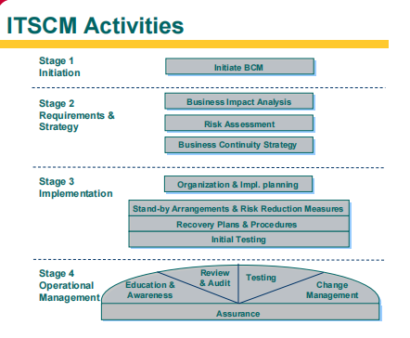
IT Service Continuity Management Activities

Slide 20
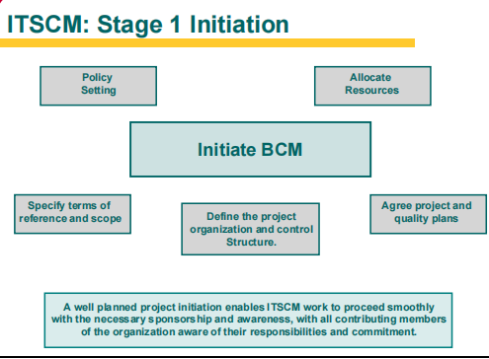
IT Service Continuity Management…

Slide 21
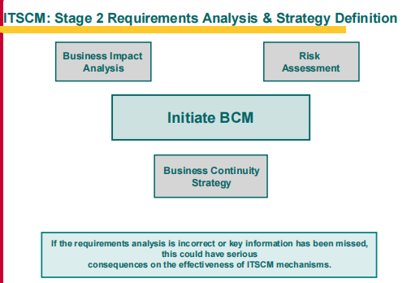
IT Service Continuity Management…

Slide 22
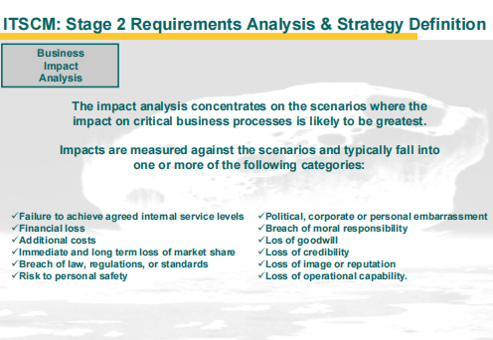
IT Service Continuity Management…

Slide 23
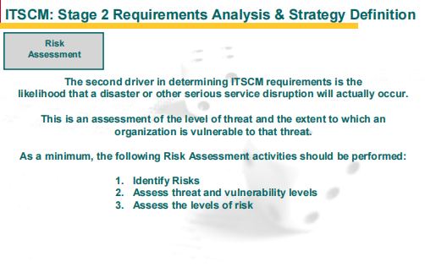
IT Service Continuity Management…

Slide 24
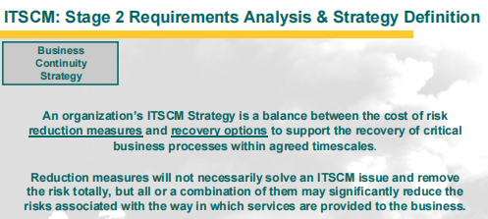
IT Service Continuity Management…

Slide 25
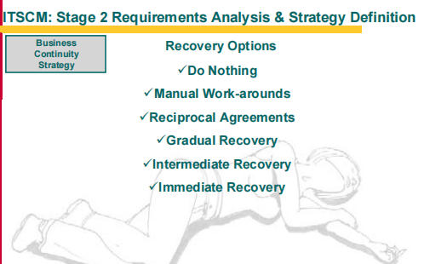
IT Service Continuity Management…

Slide 26
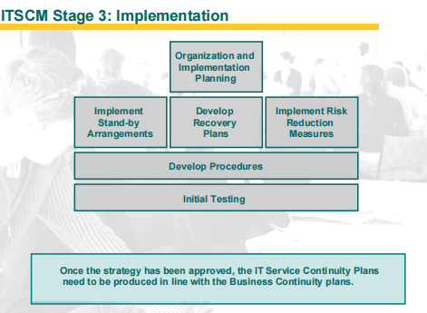
IT Service Continuity Management…

Slide 27
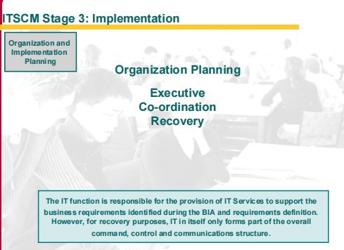
IT Service Continuity Management…

Slide 28
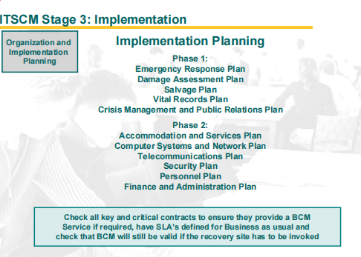
IT Service Continuity Management…

Slide 29
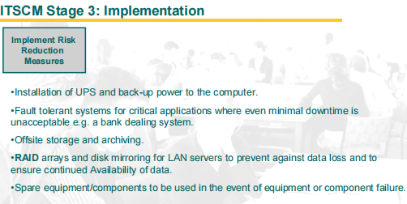
IT Service Continuity Management…

Slide 30
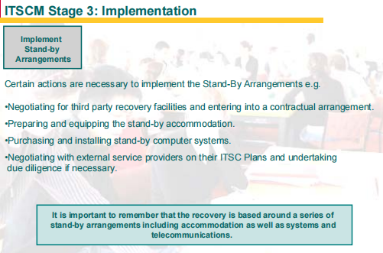
IT Service Continuity Management…

Slide 31
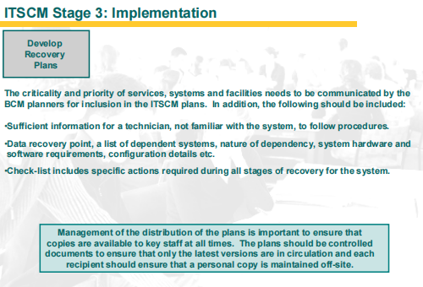
IT Service Continuity Management…

Slide 32
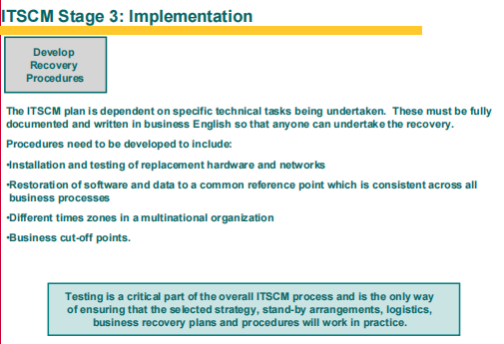
IT Service Continuity Management…

Slide 33
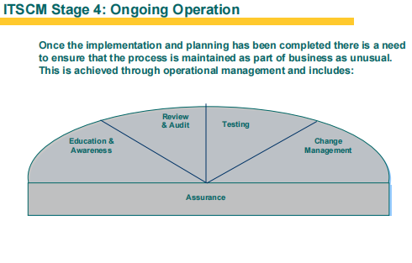
IT Service Continuity Management…

Slide 34
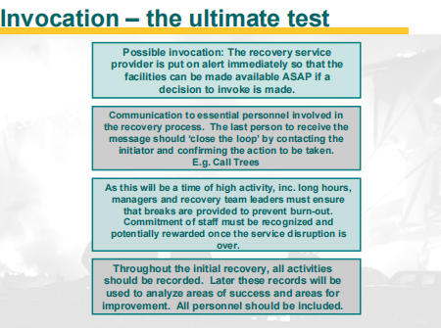
IT Service Continuity Management…

Slide 35
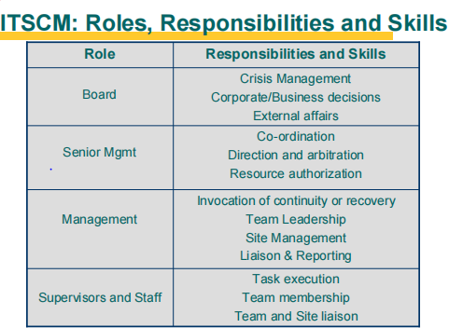
IT Service Continuity Management…

Slide 36
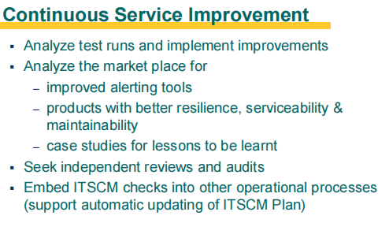
IT Service Continuity Management…

Slide 37
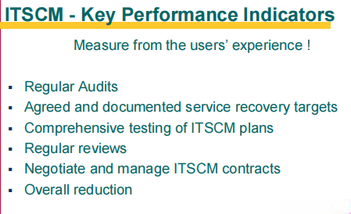
IT Service Continuity Management…

Slide 38
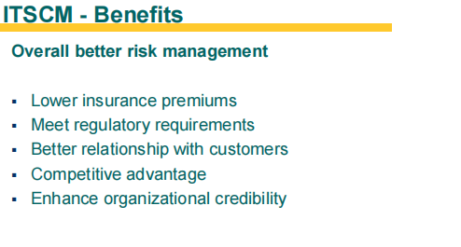
IT Service Continuity Management…

Slide 39
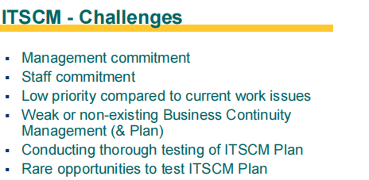
IT Service Continuity Management…

Slide 40
Risk Management
ITIL V3
ITSCM
Management of Risk (M_o_R)

Slide 41
INTRODUCTION
Risk management is a vital part of business nowadays.
Some readers think that only innovative businesses need risk management, and that there is no risk in a conservative business. However, this is not true.
There is risk in all organizations since its creation until its dissolution.
Before delving into the details of risk management, it is important to define what risk is.

Slide 42
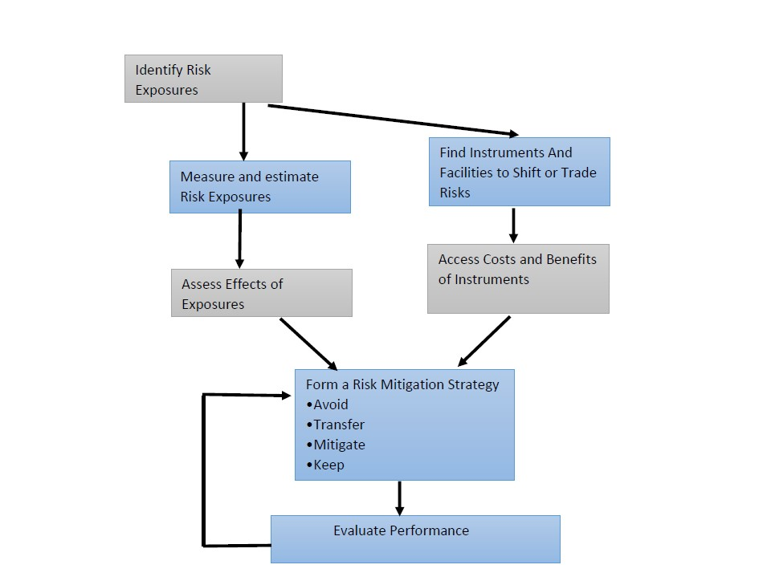
The risk management process diagram

Slide 43
The risk management process continue…
The identification of risks is the process of identifying threats, vulnerabilities, or events that may have an impact on the set of assets owned by the organization.
This identification can also be about opportunities, but not all risk management frameworks explore this.
For risk identification, experience is important because it is common for the risk source to derive from a non-deterministic cause.
After identification comes the analysis of the identified risk.

Slide 44
The risk management process continue…
Risk analysis is concerned with the gathering and measuring of information about risk exposure, so that the organization can make suitable decisions and manage risk appropriately.
Finally, risk control involves monitoring the environment for improved effectiveness against the previous set of threats, vulnerabilities, or events and make decisions about them.
These decisions can be to avoid, mitigate, transfer or keep the risk.

Slide 45
The risk management process continue…
The actual process can vary according the framework used.
Every organization has a kind of risk management that is not always explicit, well-structured or consistently applied to support decision making.
The task aim of risk management is to ensure that the organization makes a cost-effective use of a risk framework that has a set of well-defined steps.
The aim is to better support more critical decision making through a good understanding of risks and their likely impact in order to achieve competitive advantage.
IT risk management has the same goals and steps of risk management in general.

Slide 46
Why IT Risk Management Matters?
Nowadays all organizations have a very strong relationship with IT, most of them are completely dependent on it and it would not be possible to maintain large scale business without IT.
To achieve the best return of investment, avoid instability and add value to an organization, a good risk management is essential.
So the risk management on IT Service Management is an indispensable component.
We have uncountable guidelines, frameworks and tools designed to support risk management and IT Service Management.
To implement an IT Service Management framework, ITIL is usually the option

Slide 47
IT Infrastructure Library (ITIL)
ITIL is considered a framework of best practice guidance for IT Service Management and it is widely used in the business world.
ITIL It was developed by CCTA, in Norwich, England, on behalf of the British government.
The CCTA is currently the Office of Governance Commerce (OGC).
As said by the ITIL Foundation in IT Service Management, ITIL is accepted as the Best Practices for lowering process costs while improving the quality of IT services delivered to users.
It is derived from the practices of the most successful and effective people in the field.
Therefore, it would be useful to explore risk management in the context of this framework.

Slide 48
IT Infrastructure Library continue….
However, the information about risk management in the ITIL is generalist and unsatisfactory.
Compared with other IT service management frameworks, ITIL is weak in the risk management field.
This forces organizations to the implementation of a risk management framework parallel to IT Service Management which leads to a loss of efficiency and detail.
ITIL V3 has as a base for risk management with the concept of “coordinated risk assessment exercises

Slide 49
ITIL V3
This framework consists of five stages of the service lifecycle, with each stage consisting of processes or functions aligned with the IT organizational structure.
These processes can be adopted based on suitability for the team, which gives ITIL some flexibility.

Slide 50
Stages of ITIL V3
Strategy
Design
Transition
Operation
Continual Improvement

Slide 51
Stages of ITIL V3 continue…
Service Strategy, the service strategy facilitates organizations to strategize and set business goals to meet customer demands and needs.
Service Design, this stage in lifecycle includes design of service management processes, technology, infrastructure, products, processes, and functions.
Service Transition, risk and impact of any change must be taken into consideration, which is where this stage begins. Transition planning and support is focused on maintaining current functionality while deploying new organizational changes with minimal risks.

Slide 52
Stages of ITIL V3 continue…
Service Operation, Service operation is the stage where day-to-day operational tasks would fall. This stage is responsible for monitoring infrastructure and application related services and enables business to meet the needs of their customers and staff.
Continual Service Improvement, the quality check of continual service improvement ensures that throughout the lifecycle, improvement is the end goal. This is also part of service continuity management.

Slide 53
Stages of ITIL V3 continue…
Uniquely to ITIL V3 is also the four P’s of service design (which is the part of service design phase in the service lifecycle), the four P’s are:
  People: Considering the people in charge of providing IT services as well as the people who will be using them.
  Processes: Measurable processes and support needed
  Partners: Which involves vendors, manufacturers, or suppliers should be considered.
  Products: Tools, services, and technology used for the support and delivery of the service.

Slide 54
Benefits of ITIL
Strong alignment between IT and organization as a whole
Clearer expectations for both the IT service desk and their customers
Reduce costs
Improved resource utilization
Greater visibility of assets
Better management of risks, system failures, and service disruptions
Improved service level and testing

Slide 55
Limitations of ITIL
ITIL is considered a framework of best practice guidance for IT Service Management and it is widely used in the business world.
In spite of this, ITIL has some gaps in Risk Management specification.
There is just a coordination of exercises instead of a clear and owned process, what can limit the efficiency of ITIL implementation in organizations.
Our work approaches this problem and compares IT risk management in ITIL to other IT Governance Frameworks.
Despite ITIL stating that risk should be identified, measured and mitigated, it is not clear how to proceed (no concrete process is defined on how to deal with risk).

Slide 56
Limitations of ITIL continue…
To solve this, we propose to map the M_o_R risk management framework in ITIL, mapping every M_o_R process in ITIL, and therefore adopt a strong risk management in ITIL, based on specific guidelines, without changing the framework.
Besides this, we propose the introduction of new elements in the risk management ITIL process such as KRIs and a new process responsible for define risk management and guide risk management implementation in the other processes.
With this model we present its theoretical application and evaluation by experts.

Slide 57
Management of Risk Framework(M_o_R)
A standard methodology, such as the Management of Risk (M_o_R), should be used to assess and manage risks within an organization.
Risk Management is an enabling function that adds value to the activities of the organization and increases the probability of success in achieving our strategic objectives.
It’s about managing uncertainty and creating an environment where surprises are minimized.

Slide 58
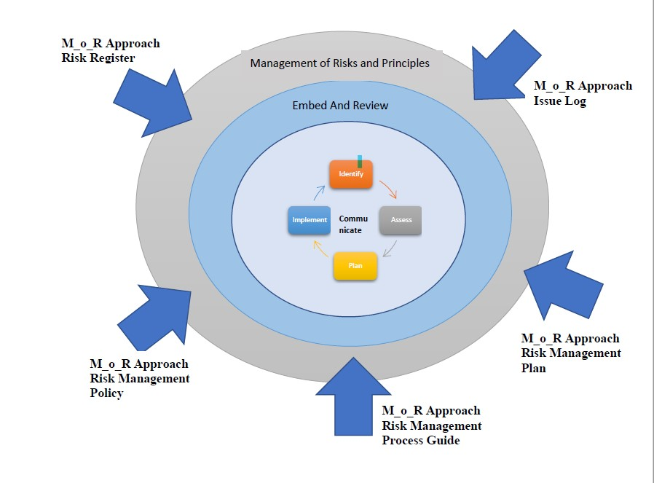
Management of Risk(M_o_R) Principles

Slide 59
(M_o_R) Principles continue…
M_o_R principles: these principles are essential for the development of good risk management practice and are derived from corporate governance principles.
M_o_R approach: an organization’s approach to these principles needs to be agreed and defined within the following living documents:
  Risk Management Policy
  Process Guide
  Plans
  Risk registers
  Issue Logs.

Slide 60
(M_o_R) Principles continue…
M_o_R Processes: the following four main steps describe the inputs, outputs and activities that ensure that risk are controlled:
  Identify: the threats and opportunities within an activity that could impact the ability to reach its objective.
  Assess: the understanding of the net effect of the identified threats and opportunities associated with an activity when aggregated together
  Plan: to prepare a specific management response that will reduce the threats and maximize the opportunities.
  Implement: the planned risk management actions monitor their effectiveness and take corrective action where responses do not match expectations.

Slide 61
(M_o_R) Principles continue…
Embedding and reviewing M_o_R:
  Having put the principles, approach and processes in place, they need to be continually reviewed and improved to ensure they remain effective.
Communication:
  Having the appropriate communication activities in place to ensure that everyone is kept up-to-date with changes in threats, opportunities and any other aspects of risk management.

Slide 62
Benefits of M_o_R
The benefits of creating a practical Risk Management Framework that can be applied across all part of the University include:
  A consistent, structured approach to identifying and managing risk.
  Supports the achievement of the University’s strategic and operational goals by managing risks that may otherwise impede success.
  Encourages an open and transparent culture where risk discussion and awareness are supported.
  Better decision making practices that support risk informed choices, prioritize actions and distinguish between alternative courses of action.
  Encourages an understanding of the risk environment within which the University operates.
  Provides assurance to the Vice Chancellor and Council that critical risks are being identified and managed effectively.

Slide 63
Risk Assessment and control
Risk assessment:
  It is a term used to describe the overall process or method where you identify hazards and risk factors that have the potential to cause harm (hazard identification).
  Analyze and evaluate the risk associated with that hazard (risk analysis, and risk evaluation).
Risk control:
  It is the set of methods by which firms evaluate potential losses and take action to reduce or eliminate such threats.
  Risk control also implements proactive changes to reduce risk in these areas.
  Risk control thus helps companies limit lost assets and income.

Slide 64
Risk Assessment and Control steps
Identify the Activity
Identify who may be at risk by the activity
Identify the hazards
Identify Associated Risks
Identify Risk rating with existing controls
Identify Additional risk controls required
Identify Risk rating with additional controls
Documentation and Initial Approval
Implement the additional risk controls identified
Monitor and review the risk controls

Slide 65
Conclusion
In order to address IT Risk in an organization:
  Ensure security and confidentiality of customer information.
  Protect against anticipated threats to the security or integrity of such information.
  Guard against the unauthorized access or use that could result in substantial harm or inconvenience.
  Restrict access to those who have a need for the information through logon ID’s and passwords.
  Insure the security of the data during processing and the destruction when no longer needed.

